Slide 1
Developing intercultural and linguistic awareness on international modules
John Holder and Joanne Hooker

Slide 2
International is everywhere!
Of specific relevance to BA (Hons) International Business Management, but also to all courses.
Integrates Home, EU and Overseas students in an assessed coursework situation.
Aims to enhance soft skills, reflexivity and employability.
Two modules involved (both 20 credits):
International Research Skills (Level 5) – core on BA IBM (40 students).
Cross-cultural Management (Level 6) – core on BA IBM and an option on a wide range of other courses in the Faculty of Business, Sport and Enterprise (85-145 students).
Both modules involve extensive use of myCourse, the SSU moodle-based VLE.

Slide 3
International Research Skills (Level 5)
Design:
Aims to maximise the benefits of international study for research.
Serves as a bridge between Levels 4 and 6, especially regarding the final year project.
Focus is on key qualitative approaches typically used by students in Level 6 projects.
2 assessments, one a survey (using Survey Monkey), one an interview; each worth 50% of the module mark. Each assessment 2,500 words.

Slide 4
Implementation:
Taught by traditional classroom contact at SSU (2 x 2h pw in Semester 1) and Distance Learning for students on Study Placement abroad.
Essential to have very clear structure and clarity in teaching and learning materials, including relevant e-books for online reference (e.g. one research skills, one theory).
Formative feedback on work in progress submitted via Turnitin.
Summative feedback via Turnitin. Students abroad also given audio feedback via Turnitin to decrease the impression of distance.
Very tight turnaround times required throughout.

Slide 5
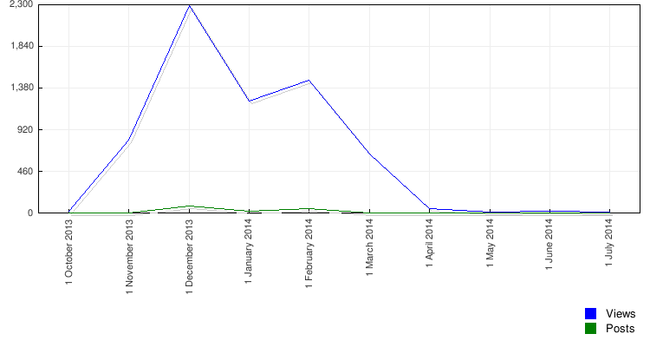
Evaluation:
“The strengths of this unit are 1. Good Teaching 2. Interesting Topics (Links with everyday events) 3. Having a undersatnding witha foreign prospctive 4. Intermedate Handing” (sic.)
“I actually think that this unit is well organised as we are well prepared to our assignments online and that we can actually follow the classes online and easily contact the tutors in case we have questions. I have not been able to see how the tutors taught something as I was abroad but the powerpoint were usefull with all information needed.” (sic.)
“Use the same learning style with both seminars. EG both use presentations rather than my course as personally this is more easy to follow.”
(Solent Unit Evaluations, June 2014)

Slide 6
Cross-cultural Management (Level 6)
Design:
Aims to maximise the benefits of studying with other students from Home / EU / overseas whilst at SSU.
Preserves individual grading at Level 6, whilst requiring group work.
2 assessments, one a 40 min. group workshop plus individual reflective statement of 250 words (individually assessed 40%), one an assignment of 2,500 words plus 250 word reflective statement (individually assessed 60%, e.g. case study).
Seeks to enhance employability and business behavioural skills (See Solent Capital Compass model (Jones and Sant 2013), and Building for growth: business priorities for education and skills. Education and skills survey (CBI/EDI 2011).

Slide 7
Employability skills:
Self Management | Meeting timeframes, managing course workloads, time management skills.
Team Working | Working in groups with others from a variety of cultural backgrounds.
Business & Customer Awareness | Developing awareness of cross-cultural factors and how these affect organisations, staff and customers.
Problem Solving Skills | Identifying cross-cultural issues facing businesses and developing reasoned solutions to resolve them.
Communication & Literacy | Applying the four language skills of listening, reading, speaking and writing to organise ideas and communicate them effectively.
Application of Numeracy | Interpreting data and analysing results appropriately.
Application of IT | Using relevant applications to organise, analyse and present work in the format required.
Relevant business behavioural skills:
Negotiation | Negotiating roles and workloads.
Conflict Management | Resolving conflicts with others, particularly those from a variety of cultural backgrounds.
Selling Skills | Presenting appropriately reasoned solutions to cross-cultural management challenges, both verbally and in writing.
Professionalism | Appropriate preparation, timeliness and conduct in informal and formal situations.
Management | Managing expectations and relationships appropriately, particularly in a cross-cultural management context.

Slide 8
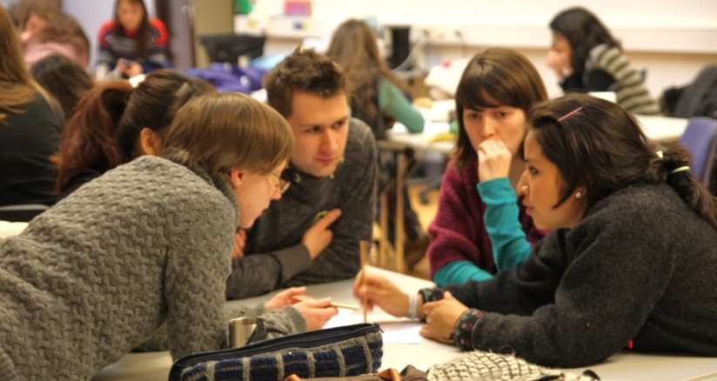
Implementation of workshops:
Selection of groups – typically 5-6 in a group,
in pairs, then tutor determined to ensure range. Students in each group select a group leader.
Topics for workshops allocated at random by tutor.
All workshop materials submitted electronically via Assessments. Notes of group contracts, meetings, etc. included as appendices.
Interactive Workshop, not just a presentation!
Individual reflective statements submitted via Turnitin.
Individually assessed; group and individual feedback via Turnitin.

Slide 9
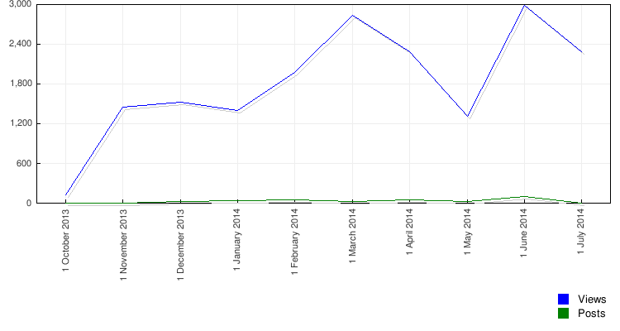
Evaluation:
“Preparing the workshop of how to develop cross cultural management effectiveness had widened my learning of skills that I would need for future employment. My time management skills were very important in this workshop as it was essential to meet deadlines that we had set, even though working in a team this was hard as those from different cultural backgrounds had other plans for the work. However this developed my understanding to how to approach those who come from different cultures. There were many issues facing the preparation, as work would not be completed on time and there were different cultural and language barriers. This affected communication as misunderstandings would occur in meetings and no questions were asked by those who did not understand the work. These problems had enhanced my skills regarding conflict management, selling skills and also my professionalism towards those in different cultures, even though help was given to guide certain decisions along the way.” (Student reflective statement, EUR171, 2014)

Slide 10
Conclusions
Reflective statements appear to help students see the links
between academic work and graduate skills.
However, students often underestimate the level of work required for a group workshop, esp. where not just a Powerpoint presentation, and overestimate their performance.
Some students seemed to genuinely learn from the experience and were self-critical, whilst others resorted to blaming others (individual vs. group accountability).
Overall, the two modules:
Improved student engagement and performance.
Increased personal, group, intercultural and linguistic awareness.
Helped students appreciate more the potential challenges and benefits of working in intercultural situations.

